Slide 1




Course Name
MAD FLUTTER

Slide 2
Gestures in Flutter
Every app, game or tool you open on your phone must includes a swipe, tap or pinch to function. These gestures are the secret to making great mobile apps work.
Gestures are primarily a way for a user to interact with a mobile (or any touch based device) application.
Gestures are generally defined as any physical action / movement of a user in the intention of activating a specific control of the mobile device.
Gestures are as simple as tapping the screen of the mobile device to more complex actions used in gaming applications

Slide 3
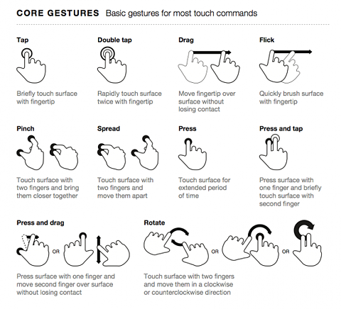
Some Basic Gestures in Mobile Apps

Slide 4
Gestures Description
Some of the widely used gestures are mentioned here:
Tap: Touching the surface of the device with fingertip for a short period. Double Tap: Tapping twice in a short time. Drag: Touching the surface of the device with fingertip and then moving the fingertip in a steady manner and then finally releasing the fingertip. Flick: Similar to dragging, but doing it in a speeder way. Pinch: Touch the surface of the device using two fingers and bring them closer together. Spread/Zoom: Touch the surface with two fingers and move them in opposite direction. Panning: Touching the surface of the device with fingertip and moving it in any direction without releasing the fingertip

Slide 5
How to Use Gestures in Flutter?
Flutter provides an excellent support for all type of gestures through its exclusive widget, Gesture Detector.
GestureDetector is a non-visual widget primarily used for detecting the user’s gesture.
To identify a gesture targeted on a widget, the widget can be placed inside GestureDetector widget. GestureDetector will capture the gesture and dispatch multiple events based on the gesture.

Slide 6
Gesture Syntax
Let us modify the hello world application to include gesture detection feature and try to understand the concept. Change the body content of the MyHomePage widget as shown below:
body: Center( child: GestureDetector( onTap: () { // do your code }, child: Text( 'Hello World’, ) ) ),

Slide 7
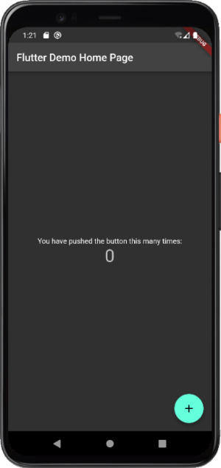
Flutter Themes
In order to share colors and font styles throughout our app, we can take advantage of themes. There are two ways to define themes:
App-wide themes are created at the root of our apps by the MaterialApp for whole application.
Theme Widgets are created for a particular part of our application
MaterialApp(
title: ‘Dark theme Demo',
theme: ThemeData.dark(),
)

Slide 8
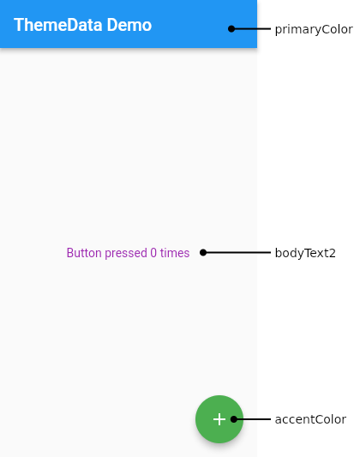
Flutter Theme cont. . .
To share a Theme across an entire app, provide a ThemeData to the MaterialApp constructor. If no theme is provided, Flutter creates a default theme for you.

Slide 9
Creating an App Theme
MaterialApp(
title: appName,
theme: ThemeData(
// Define the default brightness and colors.
brightness: Brightness.dark,
primaryColor: Colors.lightBlue[800],
// Define the default font family.
fontFamily: 'Georgia’,
// Use this to specify the default text styling for headlines, titles, bodies of text, and more.
textTheme: const TextTheme(
headline1: TextStyle(fontSize: 72.0, fontWeight: FontWeight.bold),
headline6: TextStyle(fontSize: 36.0, fontStyle: FontStyle.italic),
bodyText2: TextStyle(fontSize: 14.0, fontFamily: 'Hind'),
),),);

Slide 10
Extending the Parent Theme
Rather than overriding everything, it often makes sense to extend the parent theme.
You can handle this by using the copyWith() method.
Theme(
data: Theme.of(context).copyWith(splashColor: Colors.yellow),
child: const FloatingActionButton(
onPressed: null,
child: Icon(Icons.add),
),);

Slide 11
Themes for Part of an Application
To override the app-wide theme in part of an application, wrap a section of the app in a Theme widget.
There are two ways to approach this
Creating a unique ThemeData
Extending the parent theme
Theme(
// Create a unique theme with `ThemeData`
data: ThemeData(
splashColor: Colors.yellow,
),
child: FloatingActionButton(
onPressed: () {},
child: const Icon(Icons.add),
),
);

Slide 12

Thank
You !

